Slide 1


JANUARY 1
A presentation on The Sales method for Pens and Printers.
By Olabode Durojola

Slide 2

Business Goals
Insights for the Sales team
The sales team is looking for the following insights and the best techniques to sell the new product effectively with Either Emails, Calls or Email + Call method.
How many customers were there for each approach?
What does the spread of the revenue look like overall? And for each method?
Was there any difference in revenue over time for each of the methods?
Based on the data, which method would you recommend we continue to use?
Six weeks ago the company launched a new line of office stationery and despite the world becoming digital, there is still demand for notebooks, pens and sticky notes. The focus has been on selling products to enable their customers to be more creative, and focused on tools for brainstorming.

Slide 3
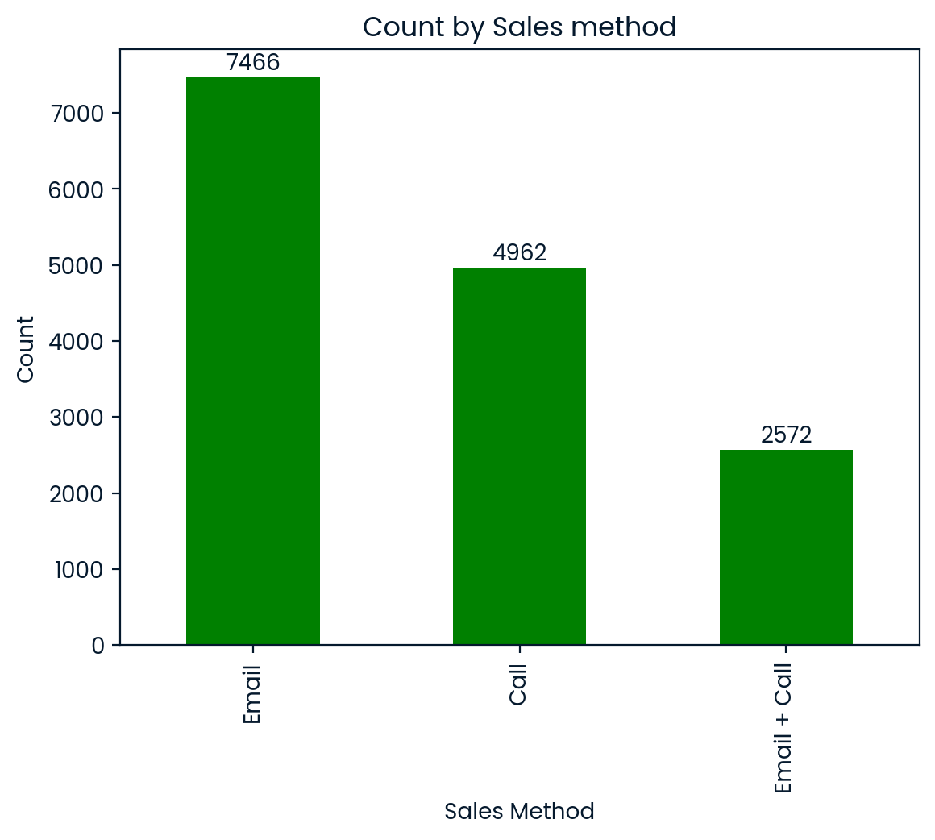
Outcomes
How many customers were there for each approach?
From the graph It's observed that 7466 customers were contacted via Emails which is almost 50% of the total sales made, and 4962 were approached via Calls which is almost twice the people approached with both Emails + calls of 2572 sales.
sdvsdvd

Slide 4
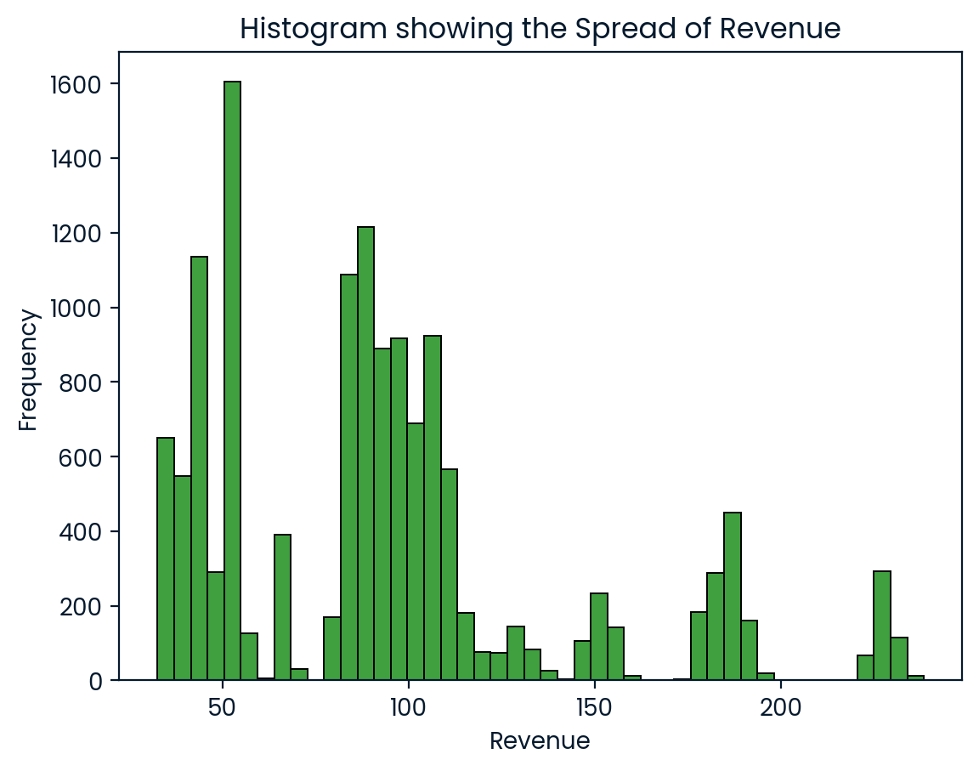
Outcome
What does the spread of the revenue look like overall? And for each method? From the histogram, it shows the several peaks at different revenue ranges, and the highest at 1600 customers on a revenue of 50, implying that revenue is coming from distinct categories of sales method due to the several peaks. Low-revenue transactions dominate the dataset around 50 and 100. There are few customers with higher expenses per purchase, above 200 per purchase as outliers.

Slide 5
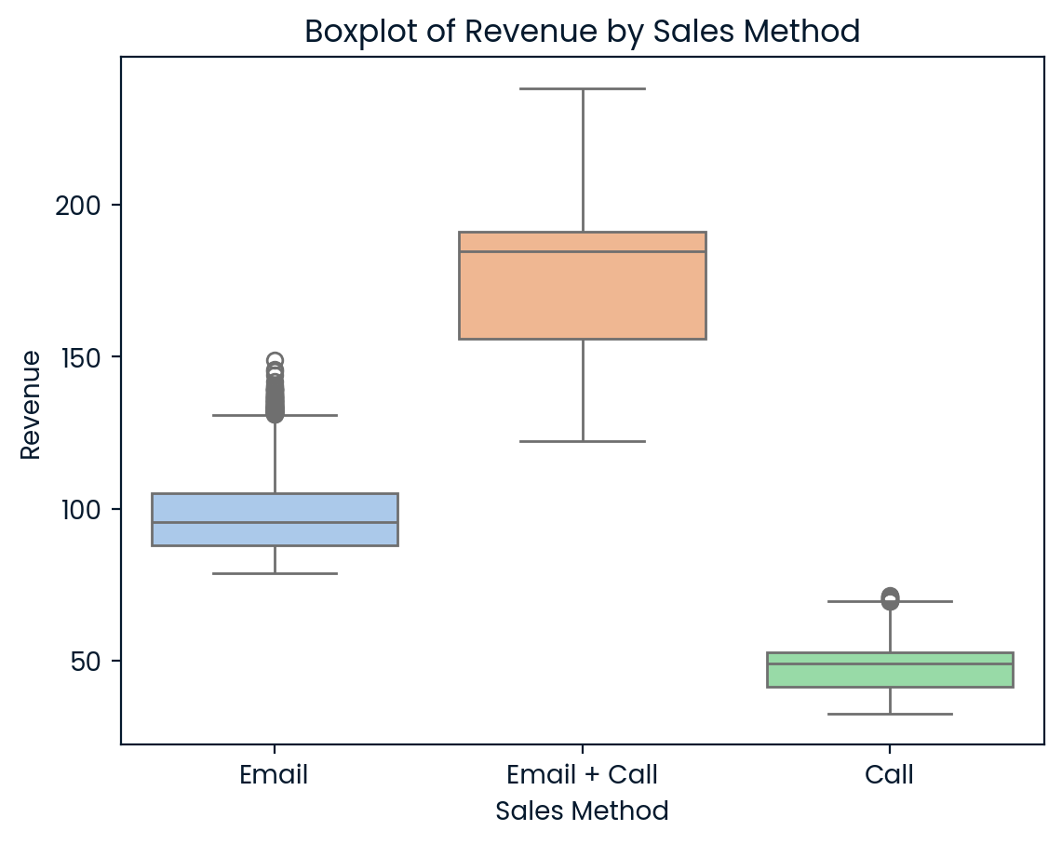
What does the spread of the revenue look like for each method?
From the the boxplot of the three sales methods, it provides a clear visualization of the revenue distribution.
While there are a few outliers above 150 for the Email method, these higher revenue values are not representative of the majority.
The Email + Call method demonstrates the largest IQR, ranging from approximately 120 to 230,displaying the highest revenue among the three methods, with no significant outliers in this category.
The Call method displays the narrowest IQR, with revenues packed between 32 and 60, reflecting limited variability and overall lower performance in revenue generation.

Slide 6
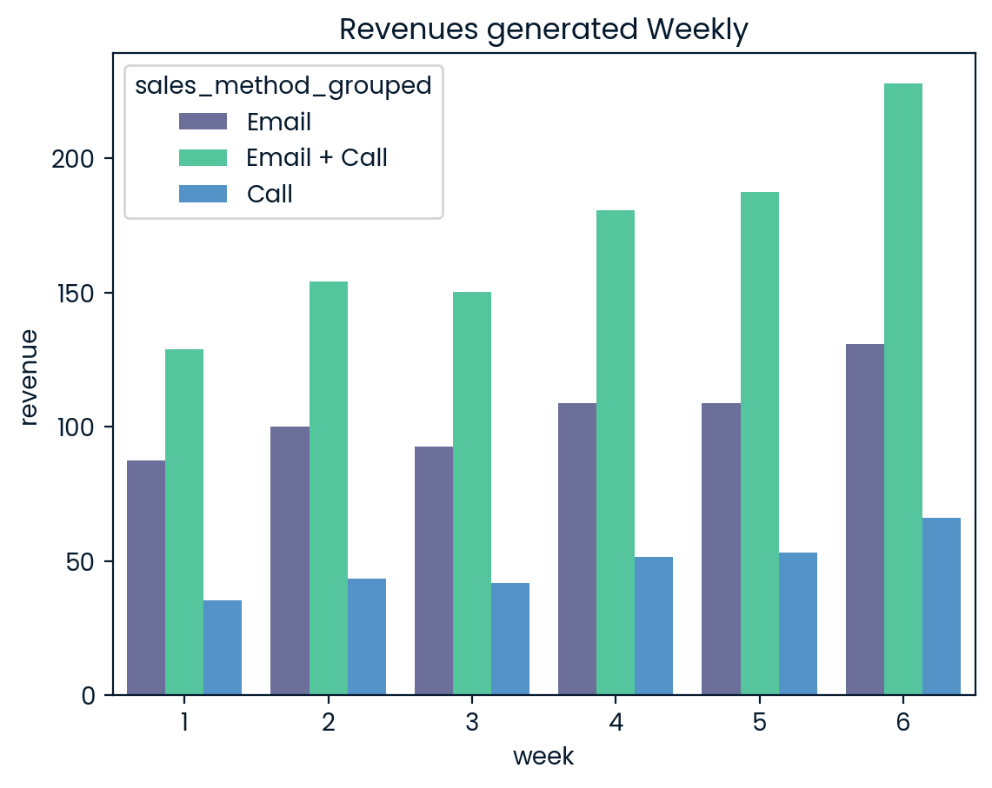
Was there any difference in revenue over time for each of the methods?
From the graph, the Email + Call method consistently generates the highest revenue each week, showing a steady upward trend and peaking in week 6, with the strongest growth among all methods.
While the Email and Call methods follow stable but less dynamic patterns.

Slide 7
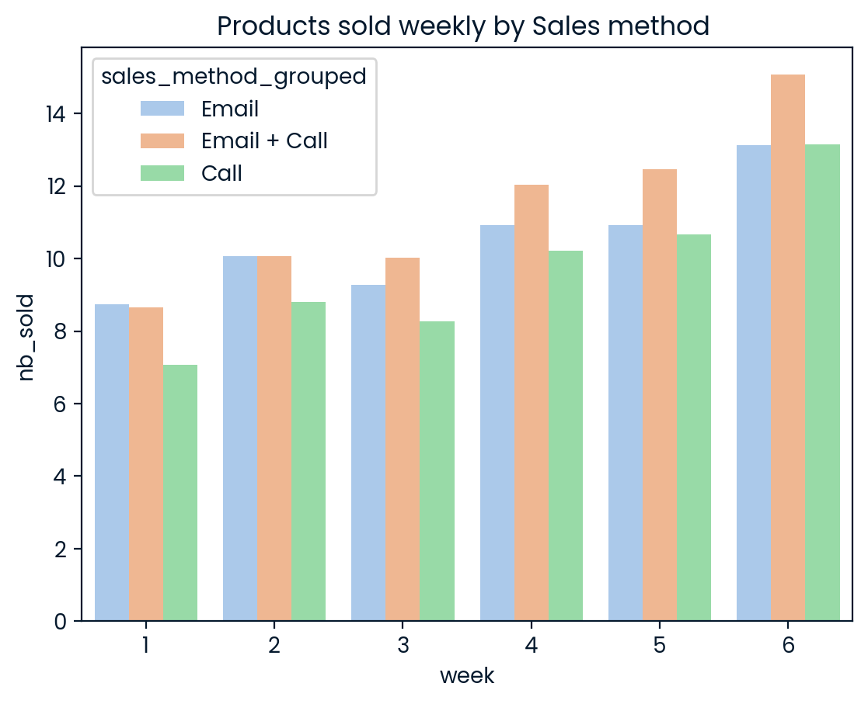
Business Metric
To identify the best sales method and boost product sales, we should visualize weekly product sales by method and evaluate performance using metrics like average items and revenue per transaction, aiming to enhance customer creativity and focus.

Slide 8
Business Metric
Email: With 72,639 items sold across 7,466 transactions, it leads in total sales volume and revenue ($672,317.83). However, its average revenue per transaction ($97.04) and items per transaction (9.73) make it ideal for high-volume, lower-value sales.
Email + Call: This approach excels in value, achieving the highest average revenue per transaction ($183.61) and items per transaction (12.23), despite fewer total sales (31,444 items, $408,256.69 revenue). It’s best suited for high-value or premium customers.
Call: With $227,563.49 revenue from 47,187 items sold, it has the lowest efficiency, averaging $47.6 revenue and 9.5 items per transaction. Its cost and time demands (30 minutes per customer) make it unsuitable moving forward.
Focus on Email + Call for high-value sales as it is consistent with highest average revenue and items sold per transaction.

Slide 9
Recommendation
Prioritize Email + Call for High-Value Sales: Focus on this method for high-value products, cross-selling, upselling, and B2B clients, as it delivers the highest revenue and items per transaction. Reserve calls only for essential interactions, such as resolving objections or converting hesitant buyers.
Optimize Email for High-Volume Sales: Invest in automation, personalization, and segmentation to maximize the Email method's reach and cost-efficiency, targeting large-scale sales while balancing resource use.
Track Key Metrics: Monitor revenue per transaction, conversion rates, customer lifetime value, and profit margins, considering deployment costs. Analyze weekly trends to fine-tune strategies and improve efficiency.
Enhance Data Analysis: Address data quality issues, such as null values in revenue, and collect additional data on customer behavior, product types, and pricing impacts. Investigate relationships between product categories, sales volume, and revenue to refine sales strategies.

Slide 10
Thank you

